Slide 1
Sample Surveys
an overview

Slide 2
We’ve all seen stats online...
How did companies arrive at these numbers?
Did they ask you? Did they ask me?
Yet, the numbers seem true...

Slide 3
Background (Sample Surveys)
Pew Research and the Gallup Poll often poll between 1005 and 1500 people to gain information about the entire American population or some subset
There are steps they take to make sure the stats they get from the poll are representative of the larger population
Why not ask everyone? It costs money to survey people and the more people you ask, the more it costs.
A census is a special type of survey when you do ask (or attempt to ask) everyone in the population

Slide 4
Vocabulary
population: the entire group of people about whom we seek to learn
statistic: a value calculated for sampled data
e.g. 68% of Americans take Dietary Supplements
sample: a representative subset (part) of a population
representative: an accurate reflection of the whole population
a statistic is representative if it is close to the population parameter

Slide 5
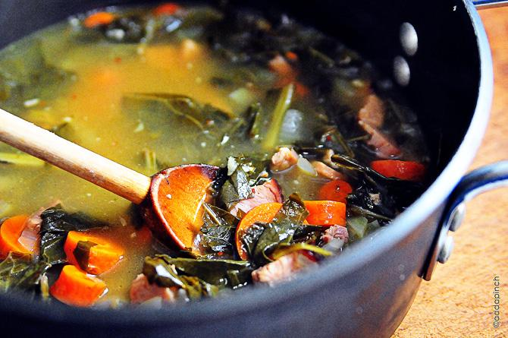
Idea #1: Examine Part of the Whole
In order to know about a population of individuals, draw a sample
Think of a pot of soup…
You don’t need to eat the entire pot to know if you like it
You could eat a cup or even a few bites to know
Key is to avoid bias
over or under emphasizing a characteristic of the population
if you salted the soup but did not stir it and took a bite off the top, it would taste salty.
that would be a biased view of the soup
STIR THE POT
Notes:
example, if you surveyed 150 students in CMSD about discrimination policies and they were 50% white, that would not match the distribution of the district and therefore would NOT be representative.
CMSD students:
Asian or Pacific Islander: 0.9%
Black, Non-Hispanic: 66.9%
Hispanic: 14.4%
American Indian or Alaskan Native: 0.2%
Multiracial: 2.9%
White, Non-Hispanic: 14.6%

Slide 6
Idea #2: Randomize
Select individuals from your population at random
can be done through random number generator programs
similar to rolling dice or flipping a coin

Slide 7
Idea #3: It’s the Sample Size
Many people believe that you need a large fraction of the population for an accurate statistic. WRONG.
If you make soup to cater a party, you do not need a bigger bowl of soup to know if it is good. You can still take a taste.
Usually a minimum of 40 people in a sample is recommended
for larger populations in order to get all of the characteristics that must be represented, need 100 - 1000
for us, we may have to go a little smaller
fine as long as we report methods

Slide 8
Simple Random Sample
Each person in the population has the same chance of being selected
each combination of people has an equal chance of being selected
abbreviated: SRS

Slide 9
Other types of samples
stratified sampling
slice a population into homogenous groups such as race or gender then doing an SRS for each group
Cluster
splitting the population into representative clusters then just sampling those clusters
Multistage sampling
combining several methods
Systematic Samples
start with randomly selected individual then following a pattern like taking every 10th person

