Slide 1
Asking Good Questions
Create your survey instrument

Slide 2
Good Questions
The questions you ask influence the information you get
Think about a test you have taken and one question was very confusing. you probably asked the teacher about it and, after clarifying, the question was easier to answer.
Clarification is not really an option on surveys/polling questions.
You want everything to be crystal clear from the start!

Slide 3
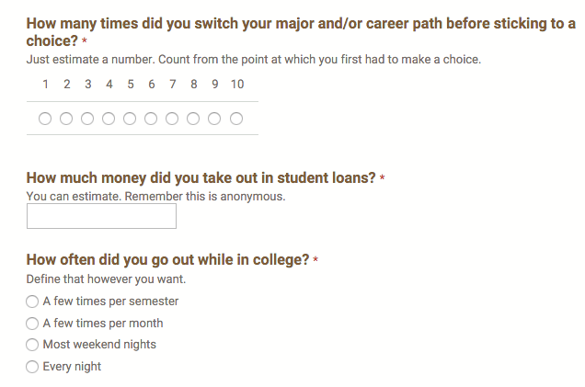
An example of a College History Survey

Slide 4
What is response bias?

Slide 5
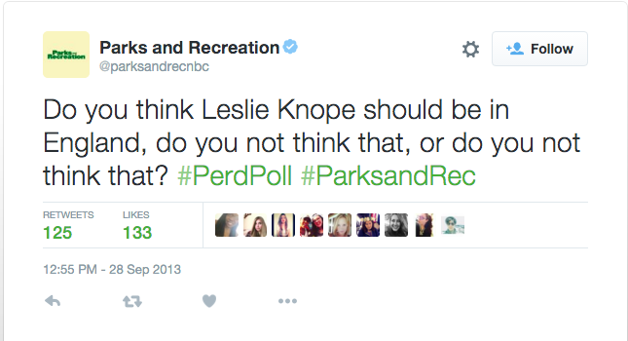
Avoid Response Bias!
Response Bias
definition: anything in a survey that influences the response from those surveyed
respondents tend to tailor their responses to attempt to please the interviewer
natural unwillingness to share personal information or admit illegal activity
wording of a question
Notes:
watch the video attached to Tweet about confusing polls

Slide 6
Examples
Amount of Homework (R. Potgeter)
Do you agree or disagree that Calvins professors assign an average amount of homework?
Agree=2
Disagree=8
Do you agree with the National College Study Program which says that Calvin assigns an average amount of homework for the college student?
Agree=6
Disagree=4
Notice that more agree in the second version. Why?
Notes:
Invoking some authority or authoritative source can alter opinions because respondents will want to align with what is “right.”
source:http://www.calvin.edu/~rpruim/courses/libarts-stats/I00/overheads/biased.shtml

Slide 7
Examples
Bathroom Size (R. Potgeter)
Do you agree or disagree that Calvin has big enough bathrooms?
Agree=5
Disagree=5
Do you agree with the National Students Rights Poll which says that Calvin has big enough bathrooms?
Agree=9
Disagree=1
How did results differ from #1 to #2? What is the difference?
Notes:
source:http://www.calvin.edu/~rpruim/courses/libarts-stats/I00/overheads/biased.shtml

Slide 8
Examples
Bathroom Size (R. Potgeter)
Do you agree or disagree that Calvin has big enough bathrooms?
Agree=5
Disagree=5
Do you agree with the National Students Rights Poll which says that Calvin has big enough bathrooms?
Agree=9
Disagree=1
Notes:
source:http://www.calvin.edu/~rpruim/courses/libarts-stats/I00/overheads/biased.shtml

Slide 9
You decide
Which question is LESS biased?
Dealing with Violent Crime (M. Higham)
What, in your view, is the best way to reduce violent crime in the U.S.:
a) reduce the number of guns sold in the U.S.
b) increase penalties for violent criminals
Should we reduce violent crime by getting guns off the streets, or should we just lock people up longer?
Notes:
Notice the difference between jail sentence connotation: in #1 “increase penalties for violent crimes” and in #2 “just lock people up longer”
source:http://www.calvin.edu/~rpruim/courses/libarts-stats/I00/overheads/biased.shtml

Slide 10
You decide
Which question is LESS biased?
Dealing with Violent Crime (M. Higham)
What, in your view, is the best way to reduce violent crime in the U.S.:
a) reduce the number of guns sold in the U.S.
b) increase penalties for violent criminals
Should we reduce violent crime by getting guns off the streets, or should we just lock people up longer?
Notes:
Notice the difference between jail sentence connotation: in #1 “increase penalties for violent crimes” and in #2 “just lock people up longer”
source:http://www.calvin.edu/~rpruim/courses/libarts-stats/I00/overheads/biased.shtml

Slide 11
Avoid bias when you write!

Slide 12
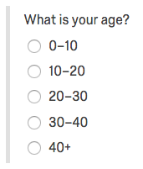
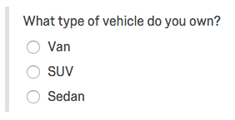
Leading Words
Choices
AVOID THEM
should, could, would
strong words like “force” or “prohibit”
examples of biased questions:
The government should force you to pay higher taxes.
How would you rate the career of legendary Joe Dimaggio?
Make sure options are mutually exclusive
need CLEAR choices
Avoid:
Too many correct answers or
No correct answers for the respondents
Notes:
What answer would you select if you were 10, 20, or 30? Questions like this will frustrate a respondent and invalidate your results.
This question has the same problem. What if the respondent owns a truck, hybrid, convertible, cross-over, motorcycle, or no vehicle at all?

Slide 13
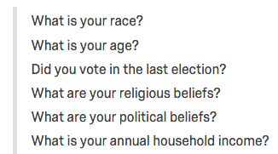
Direct Questions
“Prefer not to answer”
Make sure people know what you are asking
Don’t be vague or too open ended
ex: What do you like to do for fun?
Be specific
ex: What activity are you most willing to pay for for family fun night?
movies
play or musical
professional sports
orchestra or opera
dinner at a 4 or 5 star restaurant
dinner at a chain restaurant
Intrusive questions need an opt out
income
occupation
finances
family life
personal hygiene
personal, political, or religious beliefs
“While current research does not support that PNA (Prefer Not to Answer) options increase data quality or response rates, many respondents appreciate this non-disclosure option.”
Notes:
Source: http://www.qualtrics.com/blog/writing-survey-questions/

Slide 14
Cover all Answers
1 question at a time
include “other” if you are not sure if you made all answers available
if 10% of people select “other” you missed an answer choice
You indicated that you eat at Joe’s fast food once every three months. Why don’t you eat there more often?
There isn’t a location near my house.
I don’t like the taste of the food.
never heard of it.
Choices addressing price and nutrition are not included and could be reasons.
Don’t combine two questions into one
example: How likely are you to go out to a dinner and a movie this weekend?
Are you asking about one of those activities on separate occasions?
are you asking about the dinner and a movie date combo?
someone might misread and only answer about dinner and not consider movie attendance
Notes:
source: http://www.qualtrics.com/blog/writing-survey-questions/

Slide 15
How to avoid bias

Slide 16
Avoid Bias at all costs (literally)
Look for Bias
ask someone else to read your survey to help look for biases you may not notice
you can NOT recover from bias after the fact
biased questions leads to bad data
biased sampling method leads to bad data
bigger isn’t better
Spend time and resources reducing bias
editing, reviewing, checking, paying someone else to check again
Consider who is excluded
do not claim to have learned about a group not included in your sample survey
Pilot Test
have a small group take your survey first to make sure you are getting the kinds of info you want
look for misunderstandings, misinterpretation, confusion or other possible biases. Then refine.
Report your sampling method
when you publish results

