Slide 1
Who is My Community?
YPAR Community Project

Slide 2
Discuss in small groups
How do you define ‘community’? What community or communities do you think you are a part of?

Slide 3
Discuss as a whole group
What makes up a community?
Who is a part of a community?
Who decides who is part of a community?
Do you have to live in a community to be a part of it?
Who are the experts of the community?
Who decides when there is a problem ‘in the community’?

Slide 4
Answer individually, then discuss
Have you ever experienced a time when you were clearly out of the community? How did you know?
How can you tell when you are in a community that is not your own?
What would someone need to know about a community in order to be a part of it?
When you first came to this school (or organization), did you feel like you were a part of the community? When did you feel that this school (or organization) was “yours”? What helped you to feel this way?

Slide 5
Summary
Communities are defined in many ways by different people. Communities have unwritten rules and norms. If you are not a member of that community, you may not know what the norms are for it. Just because a person may live in the same ‘community’ as another doesn’t mean that they will agree on the way in which the community needs development or progress, help, etc.

Slide 6
Assessment
Make a large Venn Diagram; you will use this to draw images of school on one side, and a community that you are in on the other side. Label it at the top of the other circle. Draw pictures that show the differences and similarities of the two communities. Anything the two communities have in common should be drawn in the intersection of the two circles. Things that are unique to one community should be drawn in their individual circle.
Upload your drawing to SeeSaw, then comment on at least 3 other diagrams!

Slide 7
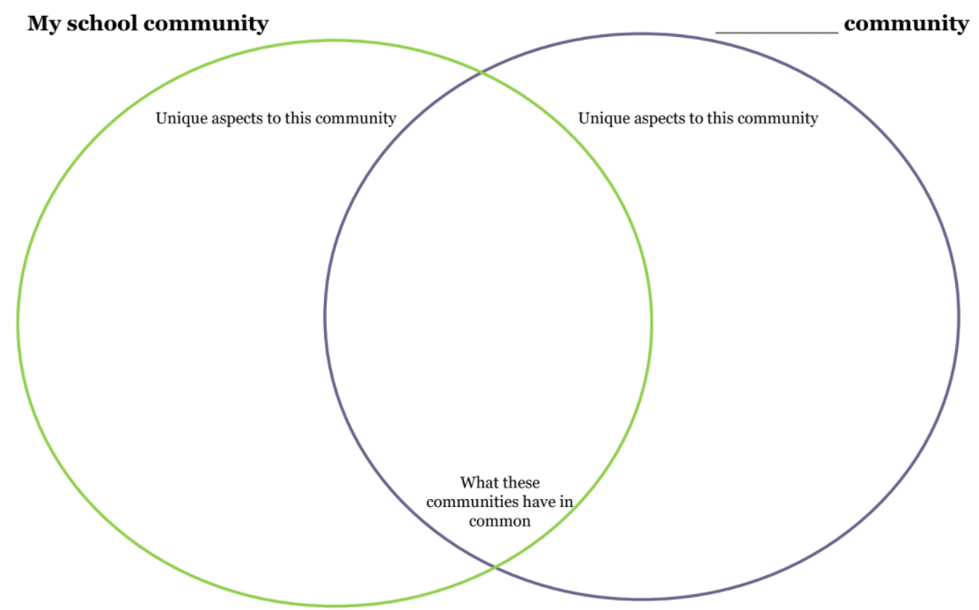
An Example of a Venn Diagram

Slide 8
Exit Slip
What do you see that is similar in this community compared to another? What seems positive about this community in the drawing?
What seems as if it needs improving about the community?

