Slide 1
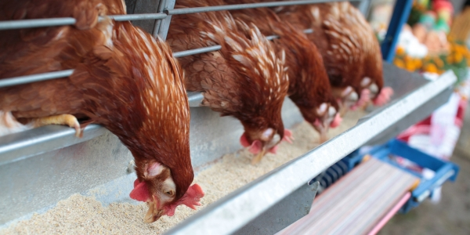
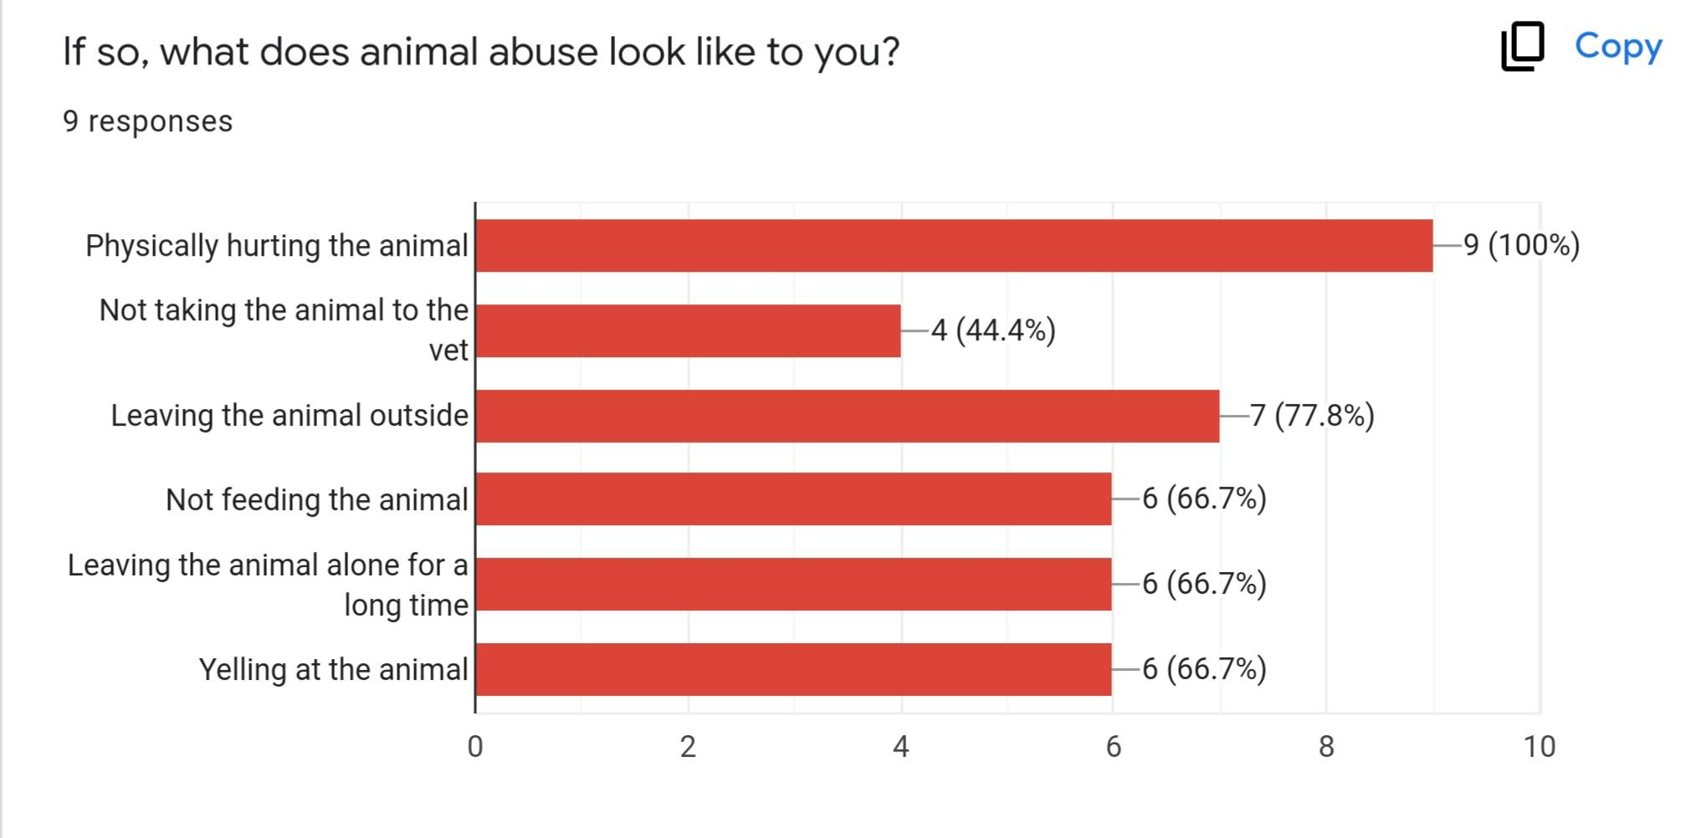
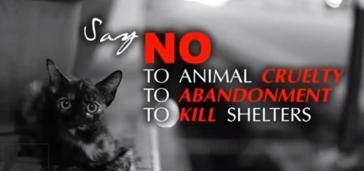
Animal Abuse Awareness: What Leads to Abuse and How Can We Prevent it?
Introduction
The purpose of our project is to spread awareness about the warning signs of animal abuse and the reasons behind it, so that people can work to better protect animals from harm. Through our research, we learned what is considered animal abuse and what the warning signs of abuse can look like. Animal abuse can include not only physically hurting an animal, but also not feeding it, leaving it outside, not taking it to the vet, and abandoning it. This can cause the animals to act anxious, avoidant, or aggressive. We surveyed individuals to see how aware they are of what causes people to abuse animals. Answers included feeling unnoticed, feeling powerless, having a mental illness, peer pressure, and substance abuse. We also asked how they thought we could prevent and bring awareness to animal abuse. Some suggested reporting it to the authorities, checking in on adopted animals every few months, and talking more about it. We encourage you to take action in supporting animals by working to stop abuse from happening.
Survey Results
We used a survey to ask individuals in the community about how aware they are of what causes people to abuse animals. Everyone felt that they knew what animal abuse was, and identified physically hurting an animal, not taking it to the vet, leaving it outside, not feeding it, leaving it alone for a long time, and yelling at it as being forms of abuse. They believed that things that could cause someone to abuse an animal are feeling unnoticed or powerless, peer pressure, and mental illnesses such as personality disorders, depression, or substance abuse disorders. Some warning signs of animal abuse that they mentioned were an animal avoiding people, seeming anxious, or being aggressive.
INSERT PICTURE HERE
Recommendations
We asked the people that responded to our survey what recommendations they had for how to help protect animals. They believe we should bring more awareness through TV commercials, report known abuse to the authorities, and make sure to check up on and account for adopted animals every few months. We also think that individuals can spread awareness through posters, flyers, and social media campaigns. We can donate to shelters who help support animals that have been victims of abuse until they can find safe homes.
INSERT PICTURE HERE
Background Information
Our research question was, “What do psychologists think causes people to hurt animals?”Through our research, we learned that nearly one million animals are abused every year, with at least one animal being abused every minute. Chickens are the most abused animals on the planet. Animals may suffer from active cruelty or passive cruelty. Active cruelty is when someone purposely harms an animal through their actions. Passive cruelty is when an animal’s needs are ignored and it is neglected. Abuse is often a punishment and a harmful way to control an animal. People who abuse animals may suffer from mental illnesses like paranoia, delusions, depression, and personality disorders.
Observations
We watched videos that discussed how many animals are abused and neglected, and how to protect them. We found that police departments and humane societies partner to respond to animal cruelty calls. Laws consider neglecting or abandoning an animal, not providing medical care, causing pain or injury, leaving an animal alone in a car, mistreating an animal, or killing an animal to be forms of abuse. Police encourage you to call when you see these types of abuse so they can investigate and protect the animals.
Main References
CBS 4 News Rio Grande Valley. “Animal Cruelty Prevention Month.” YouTube, 2017, https://www.youtube.com/watch?v=JM2caaN0MmA.
CityofPhoenixAZ. “What is Animal Cruelty? – Phoenix Pets.” YouTube, 2020, https://www.youtube.com/watch?v=Fm6yVtI1PH0.
“The Most Abused Animal on the Planet Is ...” Animals Are Not Ours, PETA, 2011, https://www.peta.org/blog/abused-animal-planet/.
Types of Animal Abuse. Weebly, https://animal-abuse-ilp.weebly.com/types-of-animal-abuse.html#:~:text=%20Active%20animal%20abuse%20is%20the%20act%20of,actual%20physical%20contact%20to%20intentionally%20harm%20the%20animal.

