Slide 1
Bellwork:
On your post-it, write as many words as you can using the letters in the word: B-I-B-L-I-O-G-R-A-P-H-Y
Today's plan:
Learn to cite sources for our poster.
Goal: I will be able to give credit to the people and groups that helped us with our research.

Slide 2
Writing A
Bibliography

Slide 3
Why a bibliography?
Helps you as the researcher keep track of the resources you used to find information about your topic
Provides acknowledgement to the authors whose work you used to inform your project

Slide 4
MLA Format
MLA stands for Modern Language Association and is a style of referencing sources.
A helpful resource while working on your bibliography is: https://style.mla.org/

Slide 5
The Basics
Each entry is made up of a list of elements in a specific order as shown here.
Each element is followed by the punctuation shown.

Slide 6
Authors
Last name, First Name and the rest of the name presented in the work.
Examples:
Ellenbogen, Charles.
Schwab, Sarah M.
Brodsky, Shayna Esther.

Slide 7
Titles
Titles of books and websites should be in italics.
Hollmichel, Stefanie. So Many Books. 2003-13,
somanybooksblog.com.
Linett, Maren Tova. Modernism, Feminism, and
Jewishness. Cambridge UP, 2007.
Titles of periodicals, tv episodes, and songs should be in quotation marks.
Beyonce. “Pretty Hurts.” Beyonce, Parkwood Entertainment, 2013, www.beyonce.com/album/beyonce/?media_view=songs.

Slide 8
Websites
Author’s last name, First name, et al. “Title of Web Page.” Title of Website, Publisher, Date published in Day Month Year Format, URL.
McNary, Dave. “Keanu Reeves, Alex Winter Returning
for ‘Bill and Ted Face the Music.’” Variety, Penske Media Corporation, 8 May 2018, variety.com/2018/film/new/bill-and-ted-3-keanu-reeves-alex-winter-1202802946/.

Slide 9
Twitter
@TwitterHandle. “Content of Tweet.” Twitter, Day Month Year, Time stamp, URL.
@Lin_Manuel. “Gmorning from a sky still blue above
the smoke from a world still full of love and hope beyond the headlines from your own best self, whispering, ‘I’m still here, and it’s never too late to put me to work.’” Twitter, 22 June 2018, 7:21 a.m., twitter.com/Lin_Manuel/status/1010165965378719745.

Slide 10
Podcast
“Title of podcast.” Title of the website, role of contributors and their First name Last name, Version, Numbers, Publisher, Publication date, URL.
“Best of Not My Job Musicians.” Wait Wait...Don’t
Tell me! From NPR, 4 June 2016, www.npr.org/podcasts/344098539/wait-wait-don-t-tell-me.

Slide 11
Your Task
Make sure that all of your resources from the past several months are credited in the bibliography section of your poster. Things that you may have consulted:
articles from a web-site
web-site
news articles
YouTube videos
TV shows or movies
social media posts
Use this site to help: https://style.mla.org/
government documents
an interview
book
??????

Slide 12
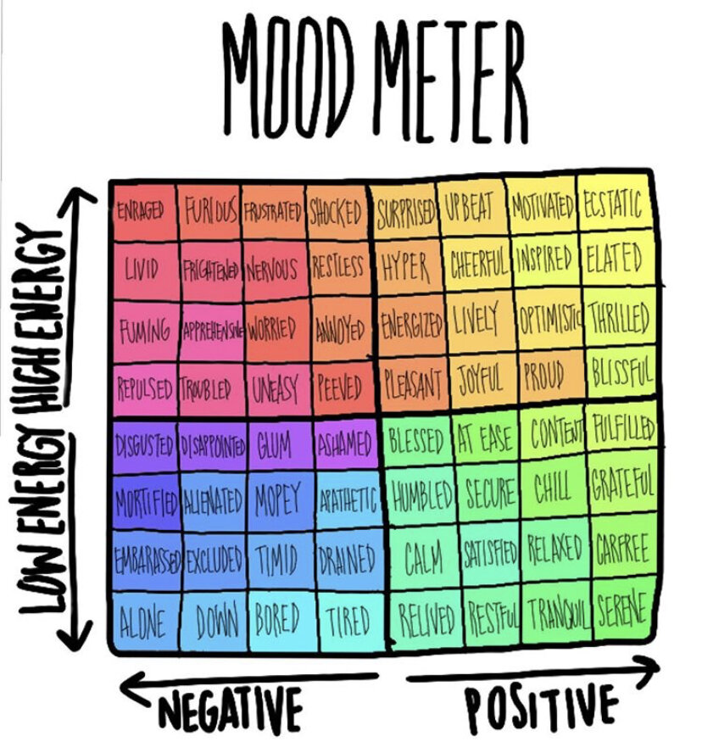
Bellwork: Mood meter - be ready to give a color of how you feel

Slide 13
Bellwork: Mood meter
Today's plan:
Continue work on our action and our posters
Goal: My group will have made progress on our tasks.

Slide 14
Human trafficking (boys) | Human trafficking (Chanel) | Student anxiety
Poster contents (especially citations) Plan out your action | Continue work on citations Fine tune poster contents Plan out action | Continue work on faculty presentation Work on citations
Police relationship | Gun violence | Verbal abuse
Reply to email Put together information for police Poster contents (especially citations) | Work on citations Fine tune poster contents Plan out action | Poster contents (especially citations) Plan out action

Slide 15
Bellwork: Mood meter - be ready to give a color of how you feel

Slide 16
Bellwork: Mood meter
Today's plan:
Continue work on our action and our posters
Goal: My group will have made progress on our tasks.

Slide 17
Drug abuse (D&S) | Drug abuse (M, C, & N) | Physical Education | Animal Abuse
Work on citations Fine tune poster contents Plan out your action | Poster contents (especially citations) Plan out action | Plan presentation to Ms. Johnson!!! Poster contents | Poster contents Plan out action
Sports | Body Shaming | Human Trafficking
E-mail Ms. Johnson again Plan presentation to Ms. Johnson Poster contents | Work on citations Fine tune poster contents Plan out action | Poster contents (especially citations) Plan out action

