Slide 1
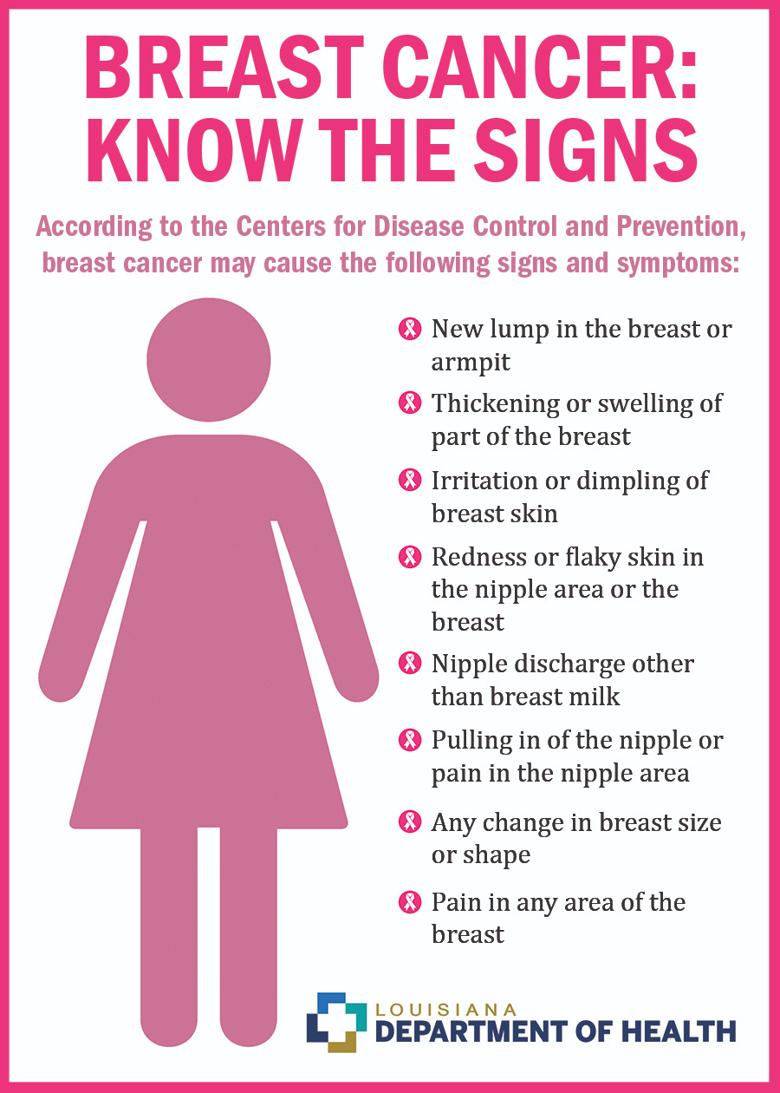
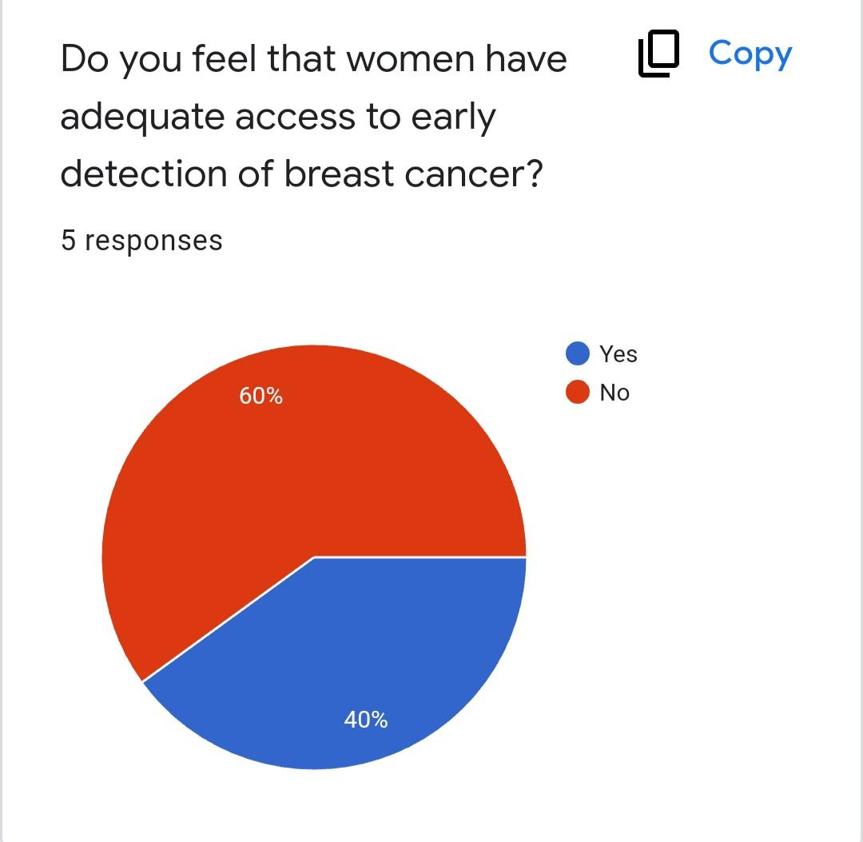
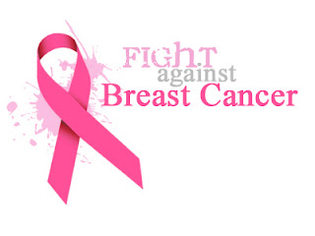
Breast Cancer: Bringing Awareness and Providing Access to Preventative Treatments
Introduction
The purpose of our project is to spread awareness about the warning signs of breast cancer, so that women can become informed of preventative measures they can take and available treatment options. Through our research, we learned about the factors that can contribute to breast cancer in women, including genetics, smoking, and obesity. We also learned that common warning signs can consist of sudden weight loss, appearance of lumps, or changes in breast size. We surveyed individuals to see what prevention and treatment options they are aware of. Responses included eating healthy, getting pre-screened, avoiding drugs and alcohol, opting for preventative surgery if high risk, chemotherapy, and taking medication. However, when asked if they believed women had adequate access to early detection of breast cancer, 60% answered no. We encourage you to take action in supporting women at risk of breast cancer by increasing early detection awareness and access.
Survey Results
We used a survey to ask individuals in the community about their knowledge of breast cancer prevention and treatment options. 60% of those that responded knew someone who has been diagnosed with breast cancer. Most were unaware of the warning signs, and did not feel that women had adequate access to early detection of the cancer. This shows that more should be done to teach women about how breast cancer develops and where to go for detection/treatment.
Recommendations
Some recommendations we have for preventing breast cancer include getting a mammogram each year, using additional screening if you have a family history of cancer, exercising, watching your weight, eating healthy, and avoiding substance use. Some things we believe can be done to raise breast cancer awareness are hosting informational classes on risks, symptoms, and treatments, making posters with facts about breast cancer, and creating social media posts to teach women about how to get screened and what signs to look for.
Observations
We watched a video that discussed the risks and treatments for breast cancer. It explained that one in eight women are diagnosed with breast cancer. Most cases of cancer are in women over 55 who have a family history of breast cancer, have never had children, do not have a healthy diet, and who smoke or drink. It is more commonly found in Caucasian women, but African American women have a higher mortality rate due to a prevalence of higher risk cancers. Some symptoms to look for are tumors, swelling, skin irritation, discharge, and redness. Ways to prevent breast cancer are getting an annual mammogram, knowing your family history, managing weight, exercising, and limiting substance use.
Background Information
The research question we studied was, “What are causes and potential cures for breast cancer?” We found that breast cancer is more commonly found in women, but some men may be diagnosed as well. Hundreds of thousands of women are diagnosed with breast cancer, and there are currently over 3 million breast cancer survivors. Cancer is caused when cells mutate too fast and cause tumors to grow in the breast. Some things that increase the risk of developing breast cancer include age, family history, and alcohol or drug use.
Main References
Wilcox, Kelly. “Breast Cancer Basics: Eight Facts Everyone Should Know.” Her Campus at Georgia Southern, 6 Oct. 2021, https://www.hercampus.com/school/georgia-southern/breast-cancer-basics-eight-facts-everyone-should-know/#:~:text=So%2C%20in%20support%20of%20awareness%2C%20here%20are%20eight,factors%20can%20be%20identified.%20...%20More%20items...%20.
WWLTV. “Breast Cancer Awareness Month:
Understanding the risks and treatments.” YouTube, 2021, https://www.youtube.com/watch?v=KQ79mRUYJTk.

