Slide 1
Bellwork:
Today's plan:
Learn to include graphs and to search for Creative Commons images.
Goal: I will be able to include images in my group´s poster.

Slide 2
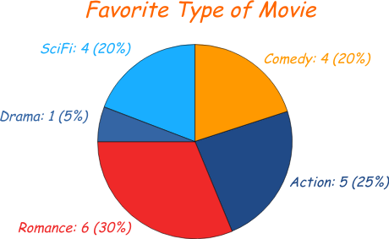
2 kinds of images to add
Charts/tables from your survey information
Reinforces your data
Draws people in
Visuals often are more powerful than numbers
Images that you find on the internet
Personalizes or humanizes the information
Looks pretty

Slide 3
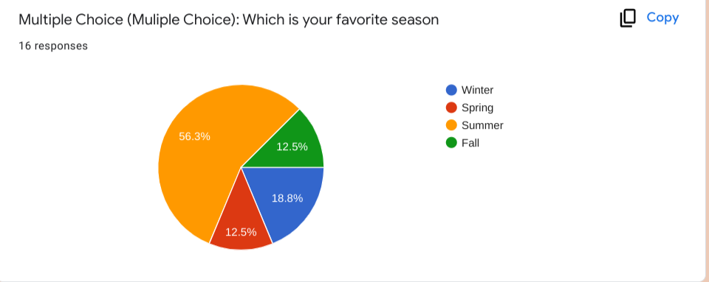
To use a chart or table from your survey:
Open the Google Form version of your survey
Click on the middle tab: Responses
Scroll to find the chart with the information you want (powerful, interesting visually)
Click copy next to the chart.
Paste it into your final poster.
Right click on the image and select
¨crop.¨ Crop the image to make it fit.

Slide 4
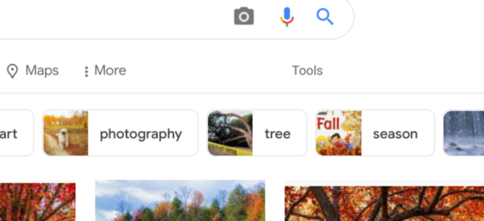
To find images that are part of Creative Commons:
Go to Google.
Search for what you would like to see in your image.
Click on ¨Images.¨
In the search area,
Click on ¨Tools.¨

Slide 5
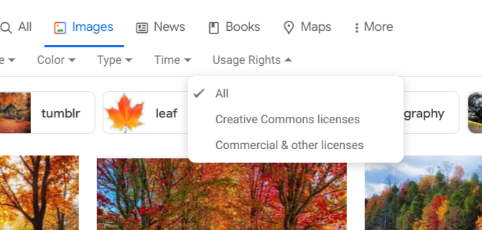
To find images that are part of Creative Commons:
5) Find the drop-down menu labeled ¨User rights.¨
6) Select the option that says ¨Creative Commons licenses.¨
7) Pick your image.
8) Right click and copy it.
9) Paste it into your poster.

