Slide 1
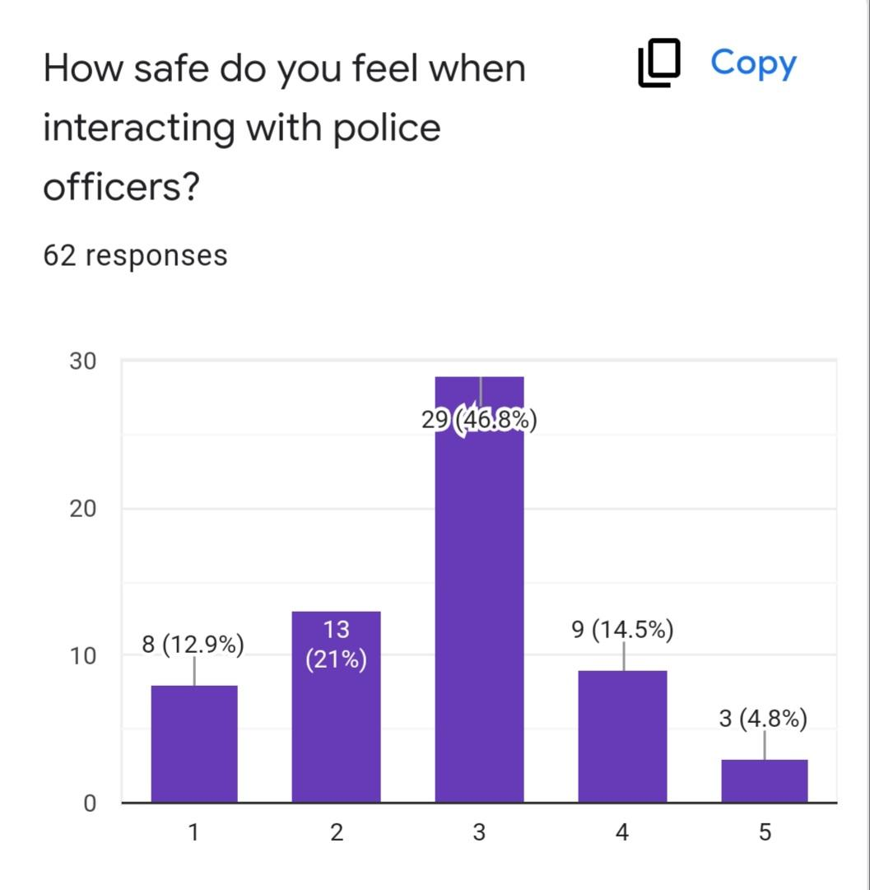
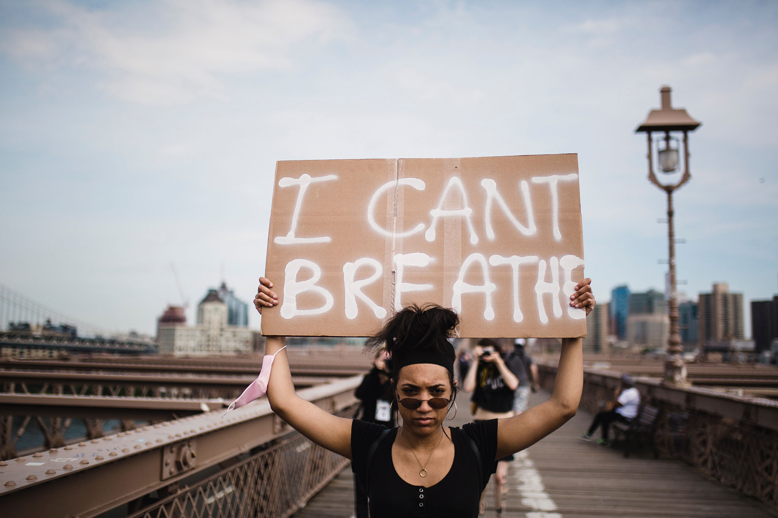
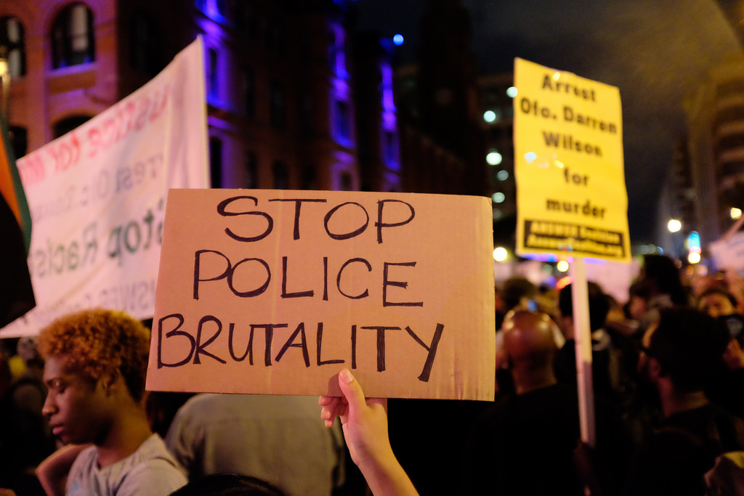
Problems in Policing: How Police Brutality Incidents are Perceived by the Community
Introduction
The purpose of our project is to spread awareness about the impact of police brutality on people of color, so that we can create police reform and help our community to heal. Through our research, we learned that many members of the community feel that police brutality makes them less safe, creates distrust, and increases crime since people are less likely to call for help. We also learned that police brutality does not impact white people the way it impacts people of color. We surveyed members of the community to see how concerned they are about the issue of police brutality and how it impacts them. 98.4% of people surveyed believed police brutality is a big issue, while 68.9% felt that those who commit police brutality are not always brought to justice. 93.5% believe that police brutality has roots in racism. We encourage you to take action to help raise awareness of the impact police brutality has on the community and find solutions to decrease it.
Survey Results
We used a survey to ask individuals in the community about how concerned they are with the issue of police brutality and how it impacts them. Most of the people we surveyed identified as African American and lived in the city. Almost everyone that responded felt that police treat people differently in the suburbs than they do in the city. When asked how safe they feel when interacting with the police, only 19.3% reported feeling safe or very safe. Many felt that police brutality is an issue in the community that makes people feel unsafe, creates distrust, and increases crime since people may be less willing to call them for help. Most felt that police brutality does not impact white people the same way it impacts people of color, and many felt that officers who use excessive force are not always brought to justice.
INSERT PICTURE HERE
Recommendations
Some recommendations we have for how to stop police brutality are for police officers to go through more training, to require body cams, and to have better screening for hiring new people. Training could help teach police about any biases they might have and how to treat members of the community equally. It could also teach them better ways to handle situations without using excessive force. Body cams could show what really happened in a situation. Better screening could prevent people that are likely to act in a biased way from becoming police officers. The police should hold each other accountable for their actions and work to rebuild the community’s trust. Members of the community should continue to speak up and protest when police brutality happens to raise awareness, and should work with the police to come up with ways to keep the community safe together without bias.
INSERT PICTURE HERE
INSERT PICTURE HERE
Background Information
The question we considered is, “What are the effects of police brutality on people of color?” Police brutality is something that we have been seeing more and more in the news. We have heard about many protests taking place across the country. We even had one here in downtown Cleveland for George Floyd, who was killed by police in Minnesota. Since this is such an important issue to talk about, we wanted to see what members of our community thought should be done to prevent police brutality and learn how it has affected their lives.
Observations
We watched videos that discussed a case where people were protesting police brutality in Elyria. We heard how police were called for domestic violence and arrested an 18-year-old male named Markese White. The video showed that while Markese was on the ground, a police officer slammed his head into the ground. People in the community were very upset by this and wanted to support Markese by speaking out against police brutality. They also signed a petition that would require Elyria police to wear body cams. These videos show that police brutality happens right here in Ohio.
Main References
Abrams, Zara. “What Works to Reduce Police Brutality.” Monitor on Psychology, American Psychological Association, 1 Oct. 2020, https://www.apa.org/monitor/2020/10/cover-police-brutality.
WKYC Channel 3. “Rally held after Elyria police officer uses force
during interaction with suspect.” YouTube, 2021,
https://www.youtube.com/watch?v=2tSZ8qJC12k.
WKYC Channel 3. “18-year-old who had head smashed into the
ground by Elyria police officerspeaks out.” YouTube, 2021,
https://www.youtube.com/watch?v=6QVG1m-5O3E.

