Slide 1
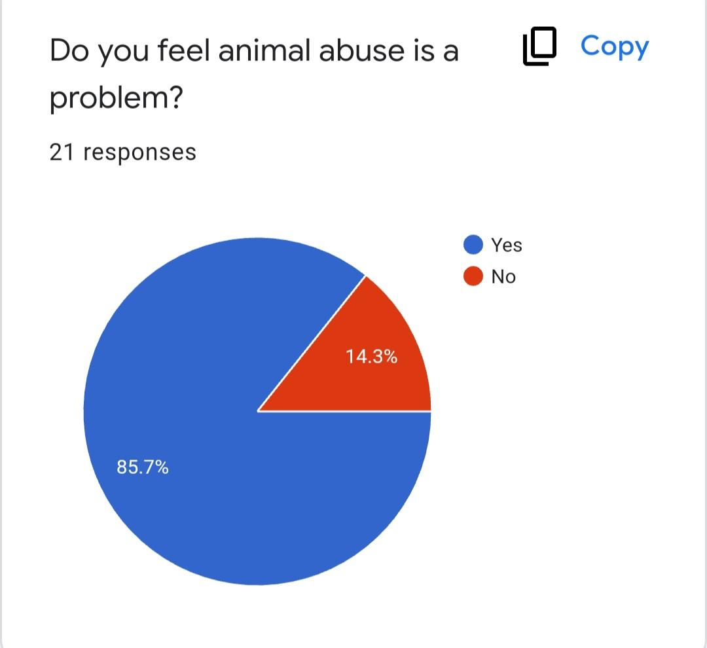
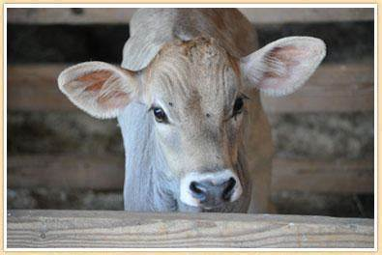
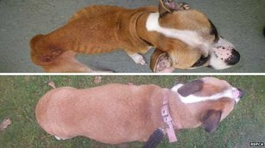
Protecting Pets: How the Community Can Keep Animals from Suffering Abuse
Introduction
The purpose of our project is to spread awareness about the mentality of animal abusers and common types of animal cruelty, so that people will know what signs to look for when trying to protect animals. Through our research, we learned that most people believe animal abuse is a very serious problem that happens as a result of things like mental illness or peer pressure. Abuse can include neglect, physical harm, and abandonment. We surveyed individuals to see if they have ever encountered animal cruelty. 42.9% answered yes, while 9.5% said they might have. 52.9% felt that dogs are the most commonly abused animal. We encourage you to take action in supporting animals by working to stop abuse from happening.
Survey Results
We used a survey to ask individuals in the community if they have ever encountered animal cruelty and how we can prevent it from happening. Our survey results showed that most people had an understanding of what animal cruelty means, and agreed that neglect, physical harm, and abandonment were the most common types. Nearly all participants felt that animal abuse is a very serious problem, which shows that we must do more to prevent cruelty from happening.
INSERT PICTURE HERE
Recommendations
We asked the individuals we surveyed what recommendations they had for preventing animal cruelty from occurring. Some suggestions they made were not letting those with substance abuse issues own animals, passing stricter laws to punish abusers, providing home checks for adopted animals, helping protect animals who have experienced abuse and been abandoned, and raising community awareness through signs or posters. We also believe that we could help animals in need by raising money and gathering donations to support the shelters that care for them until they find safe homes.
INSERT PICTURE HERE
Observations
We watched a video that discussed how animals are treated in certain farms. It focused on comparing the raising of chickens in an unhealthy factory farm environment to a healthy, natural rescue environment. Chickens in a poor environment have a higher mortality rate and bodily damage due to genetic engineering that makes them grow too large too quickly. The video compares this unhealthy fast growth to if a human baby grew to be 660 pounds in two months. This extra weight causes bone disease, fractures, and organ damage. The chickens in the factory environment also had unclean bedding that caused respiratory problems compared to those in the rescue environment. US chickens do not have federal legal protection, and 99% are fast growing breeds that experience these health problems.
Background Information
The question we chose to investigate was, “What do teens think causes people to abuse animals?” When conducting our research, we found that the most commonly abused animals are dogs, cats, horses, and livestock. 64.5% of all reported animal abuse in 2007 involved dogs, 18% involved cats, and 25% involved other animals. Livestock also suffer abuse in the food industry, especially since they are not protected or considered in many states’ animal cruelty laws. Domestic violence can also play a role in harm to animals as abusive partners may choose to target family pets.
Main References
“Inside: Animal Abuse.” Who Is the Animal Now?, Weebly, https://insideanimalabuse.weebly.com/most-abused-animals.html.
Animal Equality. “Genetic Cruelty: Investigation reveals a life of suffering for factory-farmed chickens.” YouTube, 2022, https://www.youtube.com/watch?v=j80P6FIFP8I.

