Slide 1
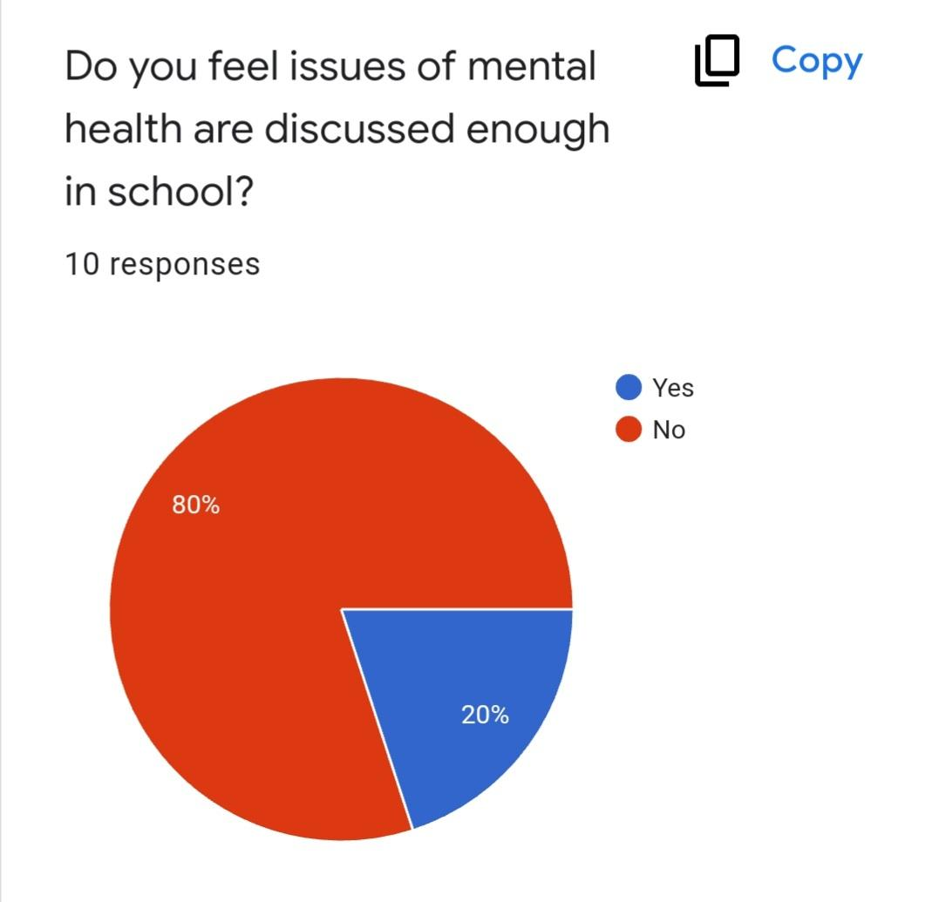
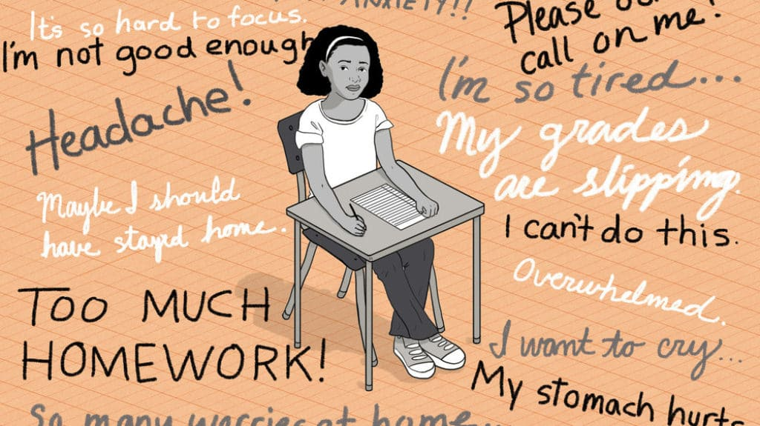
Teen Mental Health: How Schools Can Support Struggling Students
Introduction
The purpose of our project is to spread awareness about the impact that poor mental health can have on teens, so that schools can work to provide more support and resources to students in need. Through our research, we learned the warning signs of mental illness and common mental health issues teens suffer from. Warning signs can include mood swings, excessive worry, fear, inability to concentrate, sadness, avoidance, and loss of interest. Teens may suffer from anxiety, depression, insomnia, stress, and eating disorders. We surveyed students to see what they feel causes poor mental health and what they believe can be done to improve their mental wellness. We encourage you to take action in supporting students with their mental health by actively implementing solutions.
Survey Results
We used a survey to ask students at CIHS about what they feel causes poor mental health and what they believe can be done to improve their mental wellness. All students surveyed felt that mental health awareness is very important to them. They identified some of the warning signs of poor mental health as being mood swings, excessive worry or fear, inability to concentrate, sadness, avoiding situations, and losing interest. These could point to anxiety, depression, insomnia, stress, or eating disorders in students. 100% of the students surveyed responded that school and home cause mental health problems, while others listed friends, social media, and genetics as responsible. Though most students know someone struggling with mental health, they do not feel it is discussed enough in school.
INSERT PICTURE HERE
Recommendations
We asked the people that responded to our survey what recommendations they had for how to increase mental health awareness. Some solutions offered included creating a club for self-expression, taking mental health days, establishing welcoming support groups, promoting therapy, and having open discussions. We plan to encourage awareness by helping create an environment where students feel heard and supported, while spreading information about the importance of good mental health and resources. We believe schools should train teachers on mental health, direct students to resources, and have lessons on social/emotional topics. Parents can help their teens by being open to conversations about mental health, encouraging them in school, and showing an interest in their feelings.
Background Information
The research question we chose to study is, “How does poor mental health affect teens?” Mental health has become more of a problem since the pandemic, and teens have been a group that are really struggling. We learned that feelings of sadness and hopelessness have increased 40% since 2009, and that one third of high school students have felt this way. Suicide attempts have also increased by 44%. Having poor mental health can cause students to not do well in school and to make bad decisions like using drugs or engaging in risky behaviors. Through our research, we learned that everyone in a student’s life has a role to play in their mental health. Friends, schools, parents, and doctors should all be active in supporting students. Feeling connected to others and supported can help decrease the chances of students behaving in a negative way.
Observations
We watched a video that discussed ways that students can help support each other through mental health struggles. The video explained a program in Parma schools that encourages students to become mental health ambassadors. The students meet once a month and talk about how to support each other and find resources. They are involved in letting counselors know when students need someone to talk to about their mental health problems, both in the classroom and on social media. Students are able to relate to one another, which makes talking about mental health with them easier. The main message of this group is that students are not alone when dealing with mental health struggles.
Main References
“Mental Health.” Adolescent and School Health, Centers for Disease Control and Prevention, 12 May 2021, https://www.cdc.gov/healthyyouth/mental-health/index.htm.
WKYC Channel 3. “Parma high schools using 'Hope Squad'
program to address mental health.” YouTube, 2021,
https://www.youtube.com/watch?v=S6evGG00poo.

