Slide 1
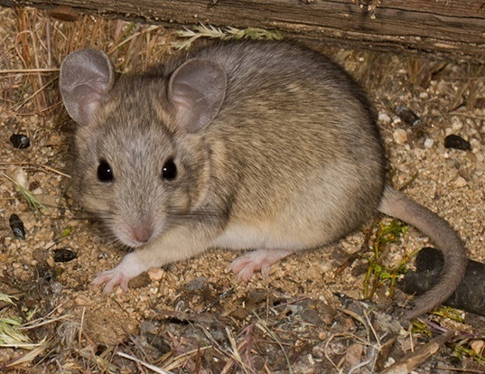
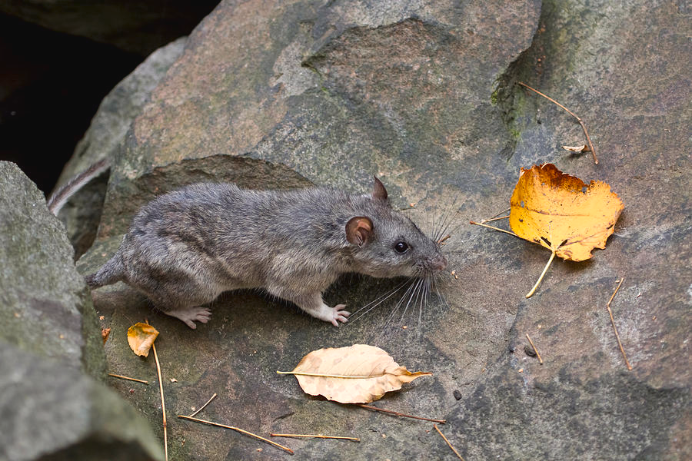
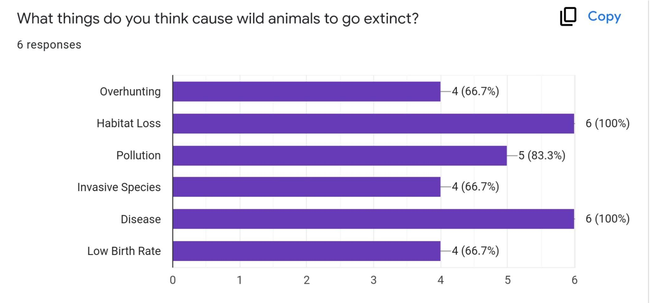
Wildlife and Extinction: The Community’s Role in Protecting the Allegheny Woodrat and Other Endangered Species
Introduction
The purpose of our project is to spread awareness about the endangerment of the Allegheny Woodrat, so that people will become more conscious of the needs of endangered species. The Allegheny Woodrat lives in Ohio and can be found in remote rocky areas. Through our research, we learned the common causes of extinction in animals like the Allegheny Woodrat and the ways that people impact their habitats. These causes can include overhunting, habitat loss, pollution, introduction of invasive species, disease, and low birth rates. We surveyed individuals to see how aware they are of animal extinction and how they feel about our role in it. We also asked what they thought we can do to protect species like the Allegheny Woodrat from going extinct. Responses included advocating, donating, supporting conservation, recycling, and decreasing pollution. We encourage you to take action in supporting wildlife by working to prevent extinction.
Survey Results
We used a survey to ask individuals in the community questions about their understanding of what causes animal extinction and our role in it. When we asked what some reasons animals become endangered are, their responses included overhunting, habitat loss, pollution, invasive species, disease, and low birth rate. The majority also felt that people may care more about protecting the Allegheny Woodrat if they knew more about it and how it interacts in the environment. Having a greater understanding of various endangered species could impact how much effort people are willing to put towards helping save them.
Recommendations
We asked the people that responded to our survey what recommendations they had for how to help protect endangered species. They suggested recycling, disposing of waste properly, supporting wildlife organizations, and advocating. We believe one way to help protect Allegheny Woodrats is to educate others on their importance through videos, posters, or advertisements. Another way is to encourage the protection of their habitats by preserving the forests they call home.
INSERT PICTURE HERE
Background Information
Our group’s research question is, “What has caused the Allegheny Woodrat to become endangered in Ohio?” When conducting our research, we focused on Allegheny Woodrats that live in Ohio and Pennsylvania, but the species can also be found in 12 other states. They are commonly referred to as “pack rats”, and are medium sized with soft fur, brown eyes, and a white underside. Allegheny Woodrats typically collect bottle caps, snail shells, and feathers. Some reasons the woodrat is endangered are a decrease in food availability, racoon roundworm parasite infection, hunting by horned owls, habitat loss due to construction of buildings and tree cutting, pollution, and barriers between rock formation homes.
Main References
“Allegheny Woodrat.” Critter Catalog, BioKIDS, http://www.biokids.umich.edu/critters/Neotoma_magister/.
“Allegheny Woodrat.” Fish & Wildlife, DNR Indiana Department of Natural Resources, 7 Oct. 2021, https://www.in.gov/dnr/fish-and-wildlife/wildlife-resources/animals/allegheny-woodrat/.
Indiana Department of Natural Resources. “Allegheny woodrats in Southern Indiana.” YouTube, 2019, https://www.youtube.com/watch?v=5hc4ezJJ674.
“Allegheny Woodrat Species Profile.” Pennsylvania Game Commission, https://www.pgc.pa.gov/Wildlife/EndangeredandThreatened/Pages/AlleghenyWoodrat.aspx.
“New Jersey Endangered and Threatened Species Field Guide.” Conserve Wildlife Foundation of New Jersey, http://www.conservewildlifenj.org/species/fieldguide/view/Neotoma%20magister/.
Observations
We watched a video that discussed how Allegheny Woodrat populations are monitored. These creatures are caught so that their DNA can be used to explore their family trees and their numbers in the wild can be tracked. They are then tagged and released back into their habitat. These woodrats like to live in holes on cliffsides they climb and between rocks for protection.

